Slide 1
Anime recommender – Unsupervised learning
Sarah Mahlangu
Busisiwe Mbewe
Lusani Gumula
Ammaarah Vaizie

Slide 2
Project Summary
Project Overview:
This project focuses on building an unsupervised anime recommendation system, similar to those used by major streaming platforms, tailored specifically for anime content. Using machine learning, the system aims to personalize user experiences, improve content discovery, predict unseen user ratings, and demonstrate key principles of collaborative and content-based recommendation systems.
Data Overview : The dataset includes key features for each anime title such as anime ID, name, genre, type, number of members, average rating, and number of episodes.
Project Objectives:
Data preprocessing and EDA : Cleaning and preprocessing the numerical and text data. Exploring the statistical distributions and the relationships between the features, word frequencies.
Feature Engineering/selection:
Model Development: Training and comparing different machine learning models, optimizing hyperparameters, and fine-tuning models for better accuracy
Model Evaluations: Evaluate Model performance by looking at RMSE
Application : Build an API that will make recommendations using models from this project in real time

Slide 3
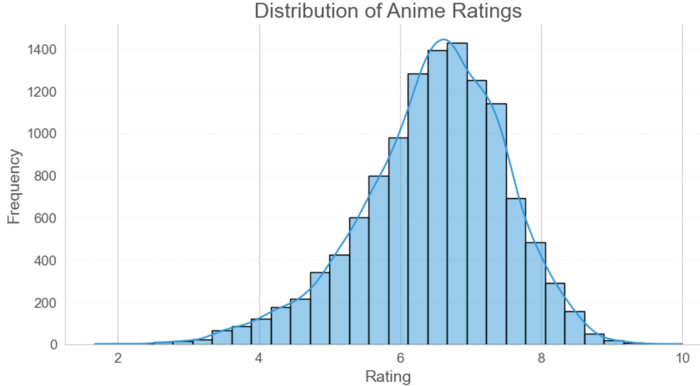
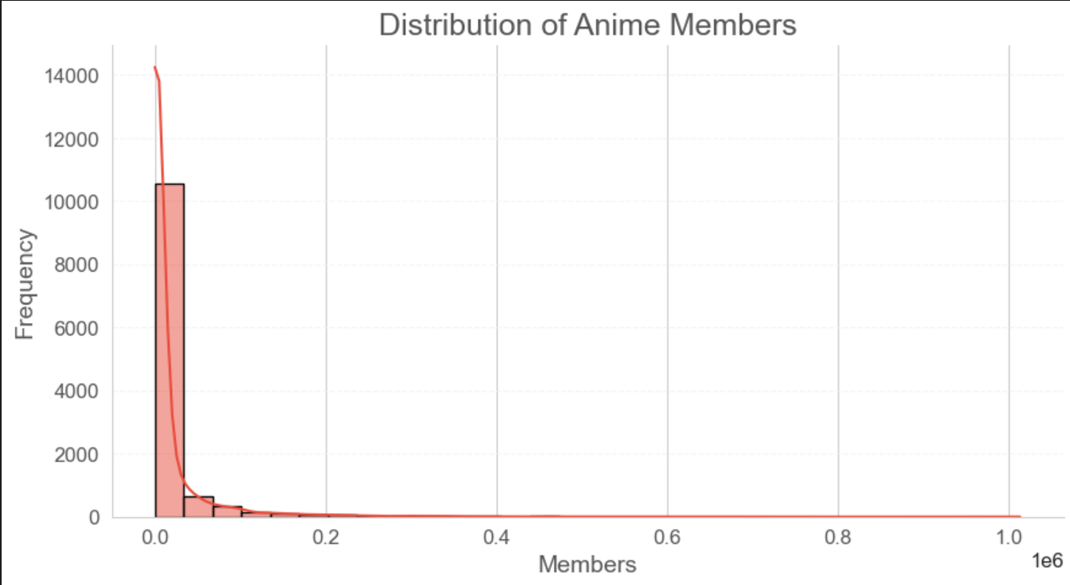
Exploratory Data Analysis
Distribution of Anime Ratings:
The distribution of anime ratings is left-skewed, with a clear concentration in the 6–8 range, suggesting that users tend to rate anime positively—likely because they choose to rate shows they enjoy—while only a small number of titles receive very low ratings.
Distribution of Anime Members:
The distribution of anime by member count is highly right-skewed, showing that most anime have relatively few members, while only a small number achieve widespread popularity. This is evident from the tall bar on the left side of the plot, representing many lesser-known titles. As member count increases, frequency drops sharply, forming a long tail that highlights the rarity of highly popular anime.

Slide 4
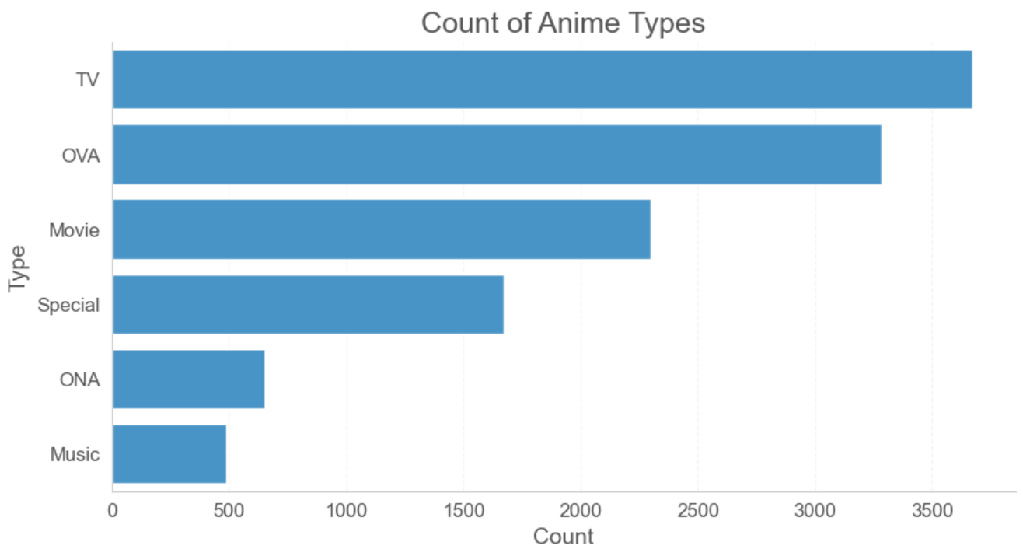
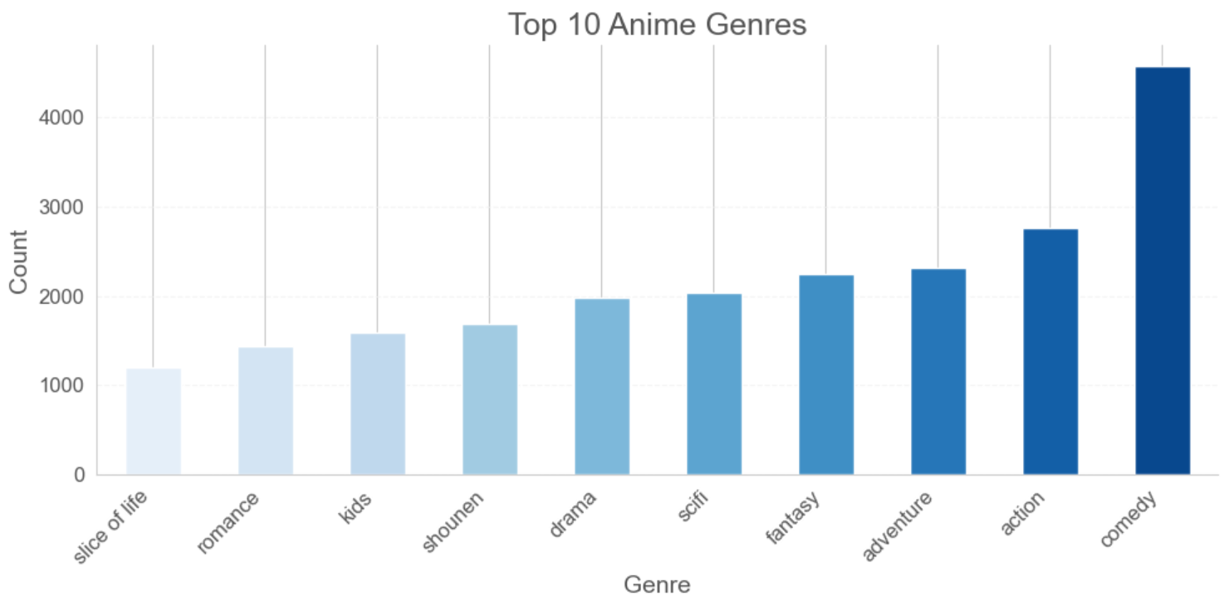
Exploratory Data Analysis
Anime Types:
TV series dominate the dataset, highlighting the popularity of serialized anime, while Original Video Animations (OVA) and Original Net Animations (ONA) also have a notable presence. Specials make up a smaller portion, and music anime are the least common, indicating their niche status.
Anime Genres:
Comedy is the most frequent genre, followed by strong interest in Action and Adventure. A variety of other genres, such as Fantasy, Sci-Fi, and Drama, also enjoy popularity, reflecting diverse audience tastes. While School and Romance genres are less common, they still appear, and the inclusion of "Kids" shows highlights a broad target audience.

Slide 5
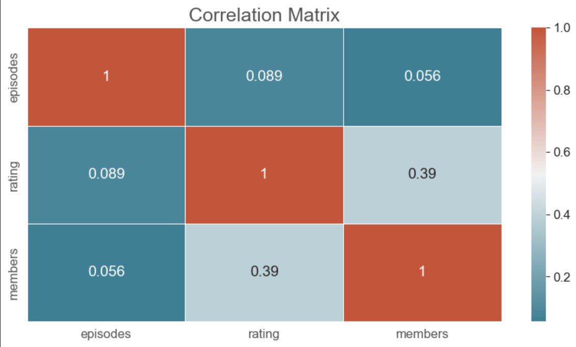
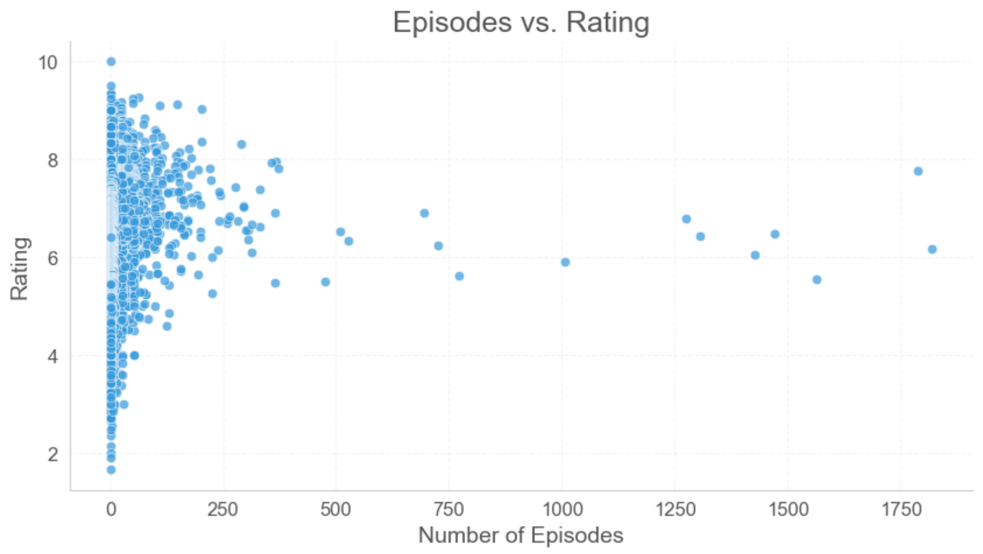
Exploratory Data Analysis
Variable Relationships:
There is a moderate positive correlation (0.39) between anime ratings and members, indicating more popular anime often have higher ratings. However, the correlation between episodes and both ratings (0.089) and members (0.056) is weak, suggesting episode count has little impact on ratings or popularity. The diagonal values of 1.0 reflect a perfect correlation with each variable.
Looking at the relationship between episodes and ratings.The scatter plot shows no strong relationship between episodes and ratings. Most high-rated anime have fewer episodes, while anime with many episodes tend to have more scattered ratings. Some long series also appear as outliers, with low ratings despite their high episode count.

Slide 6
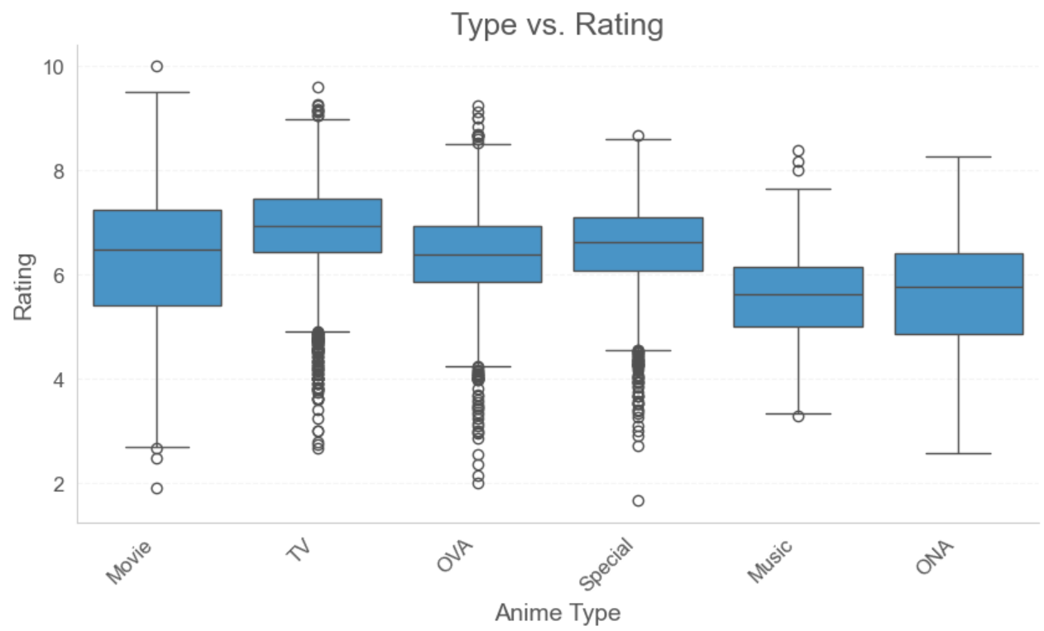
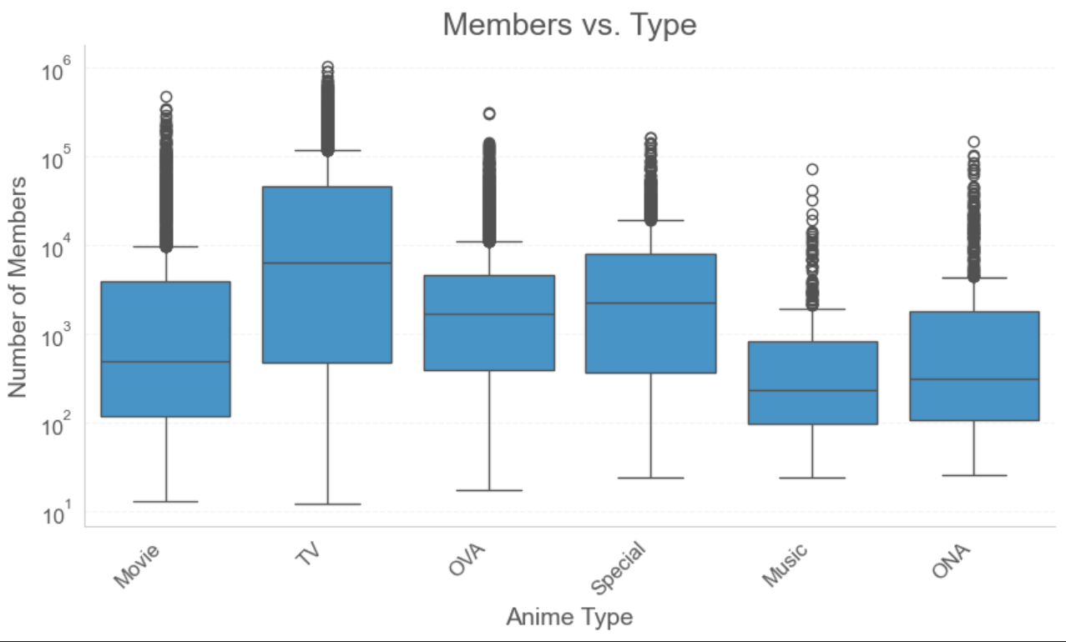
Exploratory Data Analysis
Type vs. Rating (Box Plot):
TV series and movies have the highest median ratings, with Original Video Animations (OVAs) showing similar performance. In contrast, Music and Original Net Animations (ONAs) generally receive lower ratings. Special episodes vary widely in rating, and all categories contain outliers, reflecting a mix of exceptionally high or low-rated titles.
Members vs. Type (Box Plot):
TV series have the highest median number of members, highlighting their strong popularity. Movies and Original Video Animations (OVAs) also attract substantial followings, though less than TV. Special episodes and Original Net Animations (ONAs) show moderate popularity, while Music anime have the lowest member counts, suggesting niche appeal. All anime types display a wide range in member numbers, with outliers indicating exceptionally popular titles.

Slide 7
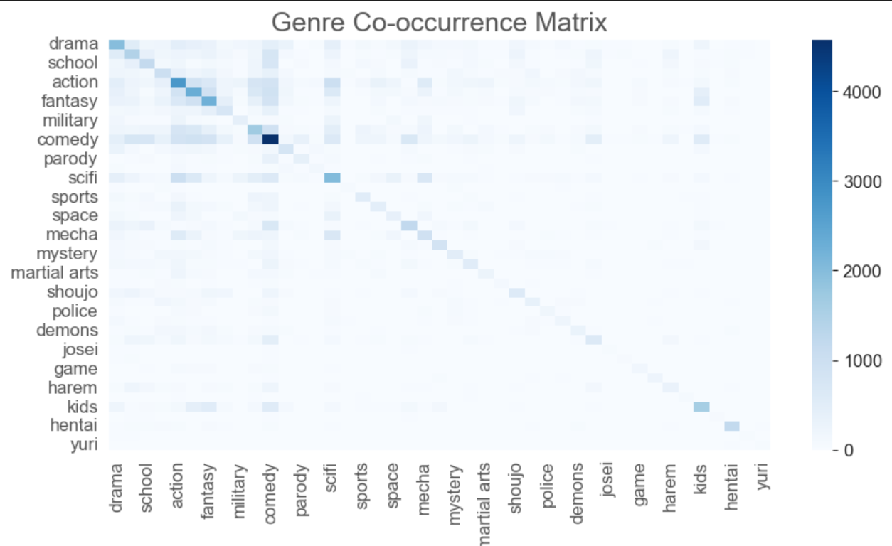
Exploratory Data Analysis
Genre Cooccurrence:
Comedy shows strong co-occurrence with many other genres, especially action, highlighting its widespread integration. Action and fantasy frequently pair together, indicating a common combination, while school and romance genres are also commonly linked. Many other genre pairings are rare, as seen in the lighter squares, suggesting these combinations occur less frequently. The dark diagonal line reflects that each genre strongly co-occurs with itself, as expected.

Slide 8
Model Development
Data Collection:
Anime data, training and test data provided
Data preprocessing:
Imputing missing values, convert text to lower case.
Model Training:
3 models trained.
1. Content-Based Filtering using Cosine Similarity
2.Collaborative Filtering using Matrix Factorization (SVD)
3.Hybrid Approach: Weighted Combination of SVD and Content-Based Similarity
Model Testing:
Verification data
Evaluation:
Using RMSE

Slide 9
Model Results: Evaluation
Collaborative:
RMSE= 2.206
Content based:
RMSE = 2.907
Hybrid:
RMSE = 2.92

Slide 10
Conclusion
The analysis shows that most users rate anime positively, with ratings between 6 and 8, though popularity is skewed, with a few titles dominating. TV series are the most common format, and comedy is the most popular genre, followed by action and adventure. There’s little correlation between the length of a series and its popularity, and certain genre pairings like Action–Fantasy and School–Romance are common. Finally, Collaborative Filtering using Singular Value Decomposition (SVD) proved the most effective model for making recommendations, outperforming other approaches with the lowest RMSE.
Future Work
To further enhance the performance and user experience of the anime recommender system, future work could explore incorporating additional user-specific data such as viewing history, watch time, or user demographics. Integrating temporal dynamics could help the system adapt to evolving preferences over time. Experimenting with advanced models such as deep learning (e.g., Neural Collaborative Filtering or Autoencoders) or graph-based recommender systems may also lead to more nuanced recommendations. Additionally, user feedback loops and explainability features could be added to improve transparency and trust in recommendations.

